Slide 1
Name
University Affiliation
Student’s Name
Course

Slide 2
A Case study on Earthquakes.
Slide 2………statement of purpose
Slide 3…….Definition of terms
Slide 4……..Data and Statistics
Slide 5………causes of earthquakes
Slides 6-9….. Newton’s laws of motion
Slide 10…Earthquake survival tips
Slide 11….conclusion
Slide 12…..references

Slide 3
Statement of purpose
The purpose of this presentation is to analyze the occurrence of natural phenomenon like earthquakes. The causes, the magnitude and intensity of the earthquakes with relation to the Newton's law of motion are analyzed and discussed.
The nature of the waves that leads to the occurrence of the earthquakes is studied. The study intends to provide earthquake preparedness tips.

Slide 4
Definition of Terms
Earthquake: an earthquake is a sudden shaking of the ground that is caused by passage of seismic waves through the earth’s rocks(Bruce, 2020).
Seismic waves, Seismic waves are elastic waves that occur as a result of an earthquake.
Fault lines: A fault line is a break in the ground which is as a result of Earth's tectonic plates moving towards the points where the earthquakes are likely to occur.
subduction Zones, A subduction zone is a zone that results when two tectonic plates meet and one slides underneath the other, curving down into the mantle( Oskin, 2015).
Plate tectonics: a plate tectonic is a theory in geology which states that the lithosphere is divided into small plates that move independently over the mantle.
Richer Scale: A Richer scale is a numerical scale that expresses the magnitude of an earthquakes on the basis of seismographic oscillations.

Slide 5
Definition of Terms cont…
Mercalli Scale: A Mercalli scale is a twelve point scale that expresses the local intensity of an earthquake. It ranges from roman one to roman 12.
Newton's laws of motion: The first Newton's law of motion states that a body in motion remains in its state of motion unless acted upon by external forces.
The second law states that the rate of change of time of a body is equal in both magnitude and direction
The third law of motion states that for every collision, there is a resultant force that is equal and opposite.
Force: Force refers to a push or a pull on an object.
Acceleration: This is the rate of change of velocity.
Gravity refers to the attraction of a body or an object towards the center of the earth.

Slide 6
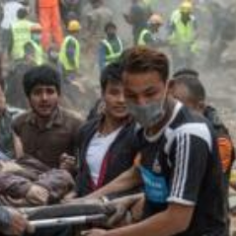
Data and Statistics
The effects are always fatal. Millions of lives were claimed.
The earthquake leads to destruction of houses, infrastructure and destruction of property that leads to destruction of the economy.
The earthquake had a greater magnitude of 4and recorded a richer scale of 6 and the Mercalli scale of 12 which are both described as fatal and destructive.

Slide 7
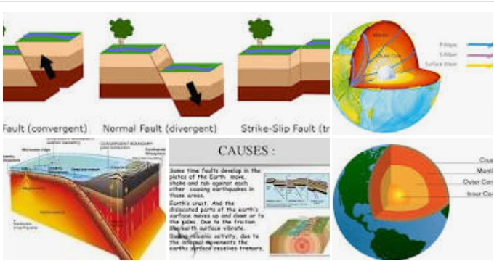
Causes of an Earthquake
An earthquake is caused by the sudden release of energy in the epicenter of the earth's crust. This leads to production of seismic waves that leads to the shaking of the ground.
A wave is a transmission of a disturbance. There are three types of seismic waves which are
Primary waves, secondary waves and surface waves. Primary waves are the first to be transmitted, followed by secondary waves. The surface waves move along the surface of the earth.

Slide 8
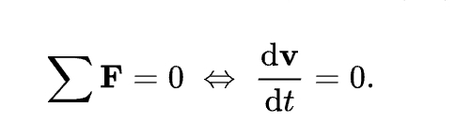
Detailed information on Newton’s Laws of motion.
Newton’s first law states that a body in motion or remains in its state of motion unless acted upon by external forces. In the same way, the earths crust remains in its state of rest unless seismic waves causes a disturbance that causes an earthquake to occur. Mathematically, it can be expressed as:
It is also known as the law of uniform motion.

Slide 9
The second law of motion
The second law states that the rate of change of momentum is directly proportional to the applied force. Mathematically, it is expressed as:
F= dp/dt=d(mv)/dt
In terms of acceleration, the law can be manipulated and written as:
F=mdv/dt=ma
It is interpreted as a product of mass and acceleration. Increase in mass leads to increase in force and therefore a greater mass of the earths crust moves at a higher velocity, which increases the intensity of an earthquake.

Slide 10
Second law of motion continued
F represents the net force applied, m is the mass of the body, in this case the mass of the crystal rocks in motion to cause an earthquake. This implies that the net force applied is directly proportional to acceleration. The second law is also know as the law of conservation of energy. This id because when the net force id zero, the momentum is constant.

Slide 11
Newton’s third law of motion
The third law states that all the forces between two objects exist in an opposite direction and equal magnitude.
In any case if an object A exerts a force say Fa on another object B, then the B exerts a pressure Fb simultaneously on A such that the two forces are equal in magnitude.
The mathematical expression of the third law is:
Fa=Fb

Slide 12
Earthquake Survival Tips
In case of the occurrence of an earthquake, stay indoors if at all you bare indoors. Get under a table or a desk and stay there for as long as the earthquake will take. Avoid any motions down or up the stairs.
If in any case you are outside the house or any structure, move to an open field away from buildings as buildings may collapse and cause injury.
If you are in a moving vehicle , maybe driving, carefully move the vehicle away from the traffic. Make sure that you do not stop under a bridge as it may collapse. Stay inside the car until when the trembling stops and start moving.
In mountainous areas, you should be extra keen and watch out the falling of rocks, trees, and any necessary landslides

Slide 13
conclusion
In the event of an audience, utmost care should be considered to enhance safety.
Earthquakes are deadly and fatal.

Slide 14
References
Bolt, A. B. (2020). Earthquake | Definition, Causes, Effects, & Facts. Encyclopedia Britannica.
https://www.britannica.com/science/earthquake-geology
Marazi, F., & Tirelli, D. (2010). Combating Earthquakes: Designing and Testing Anti-seismic Buildings. Science in School | Www.scienceinschool.org. https://www.scienceinschool.org/2010/issue15/earthquakes
Oskin, B. (2015, May 7). What Is a Subduction Zone? Livescience.com. https://www.google.com/amp/s/www.livescience.com/amp/43220-subduction-zone-definition.html
USGS. (2017). What Should I Do DURING an Earthquake? USGS.gov | Science for a Changing World. https://www.usgs.gov/faqs/what-should-i-do-during-earthquake?qt-news_scince_products

